Slide 1

PROJECT
gaming INFO

Slide 2
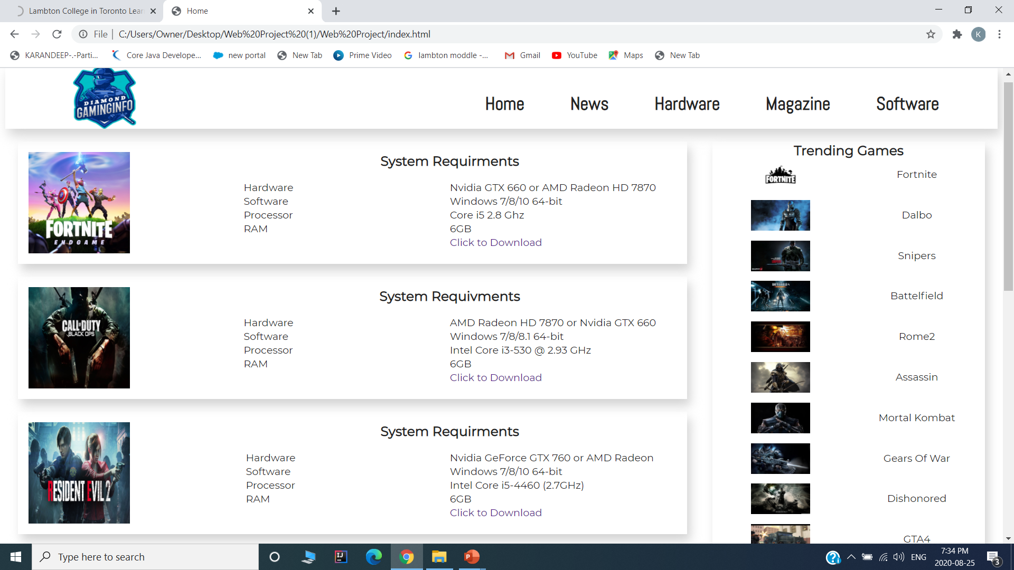
HOME PAGE

Slide 3
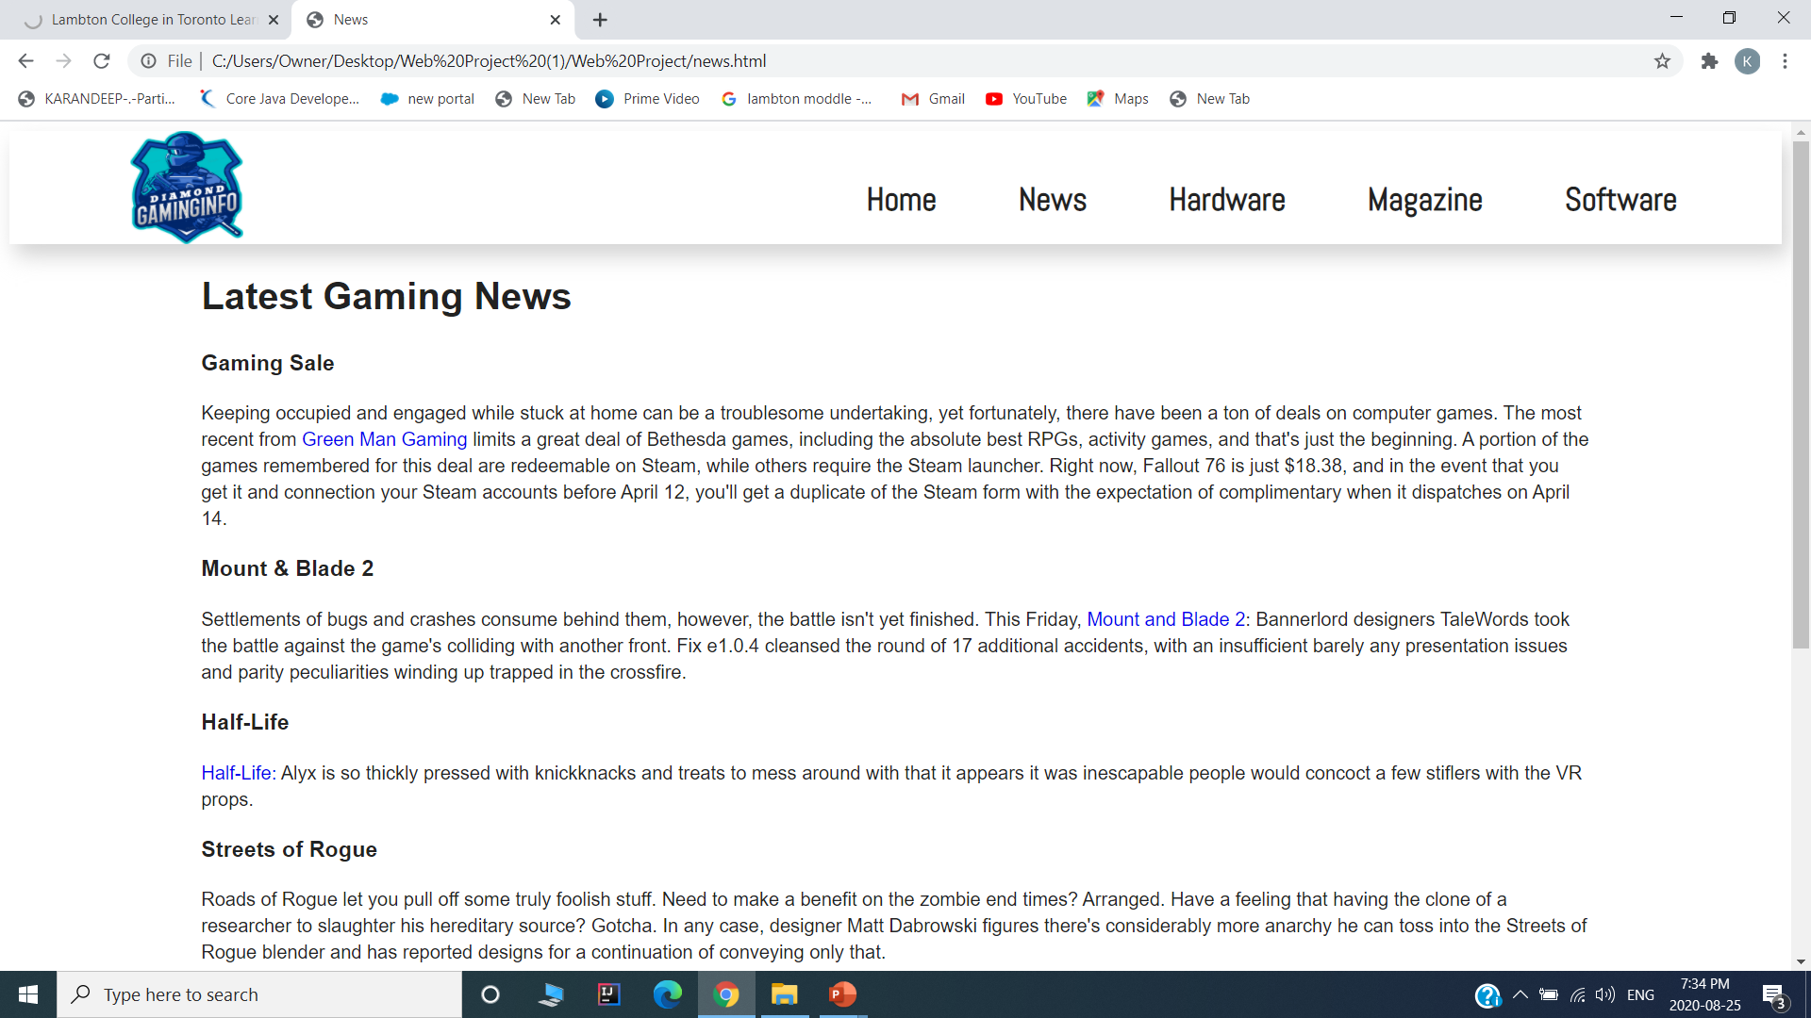
NEWS

Slide 4
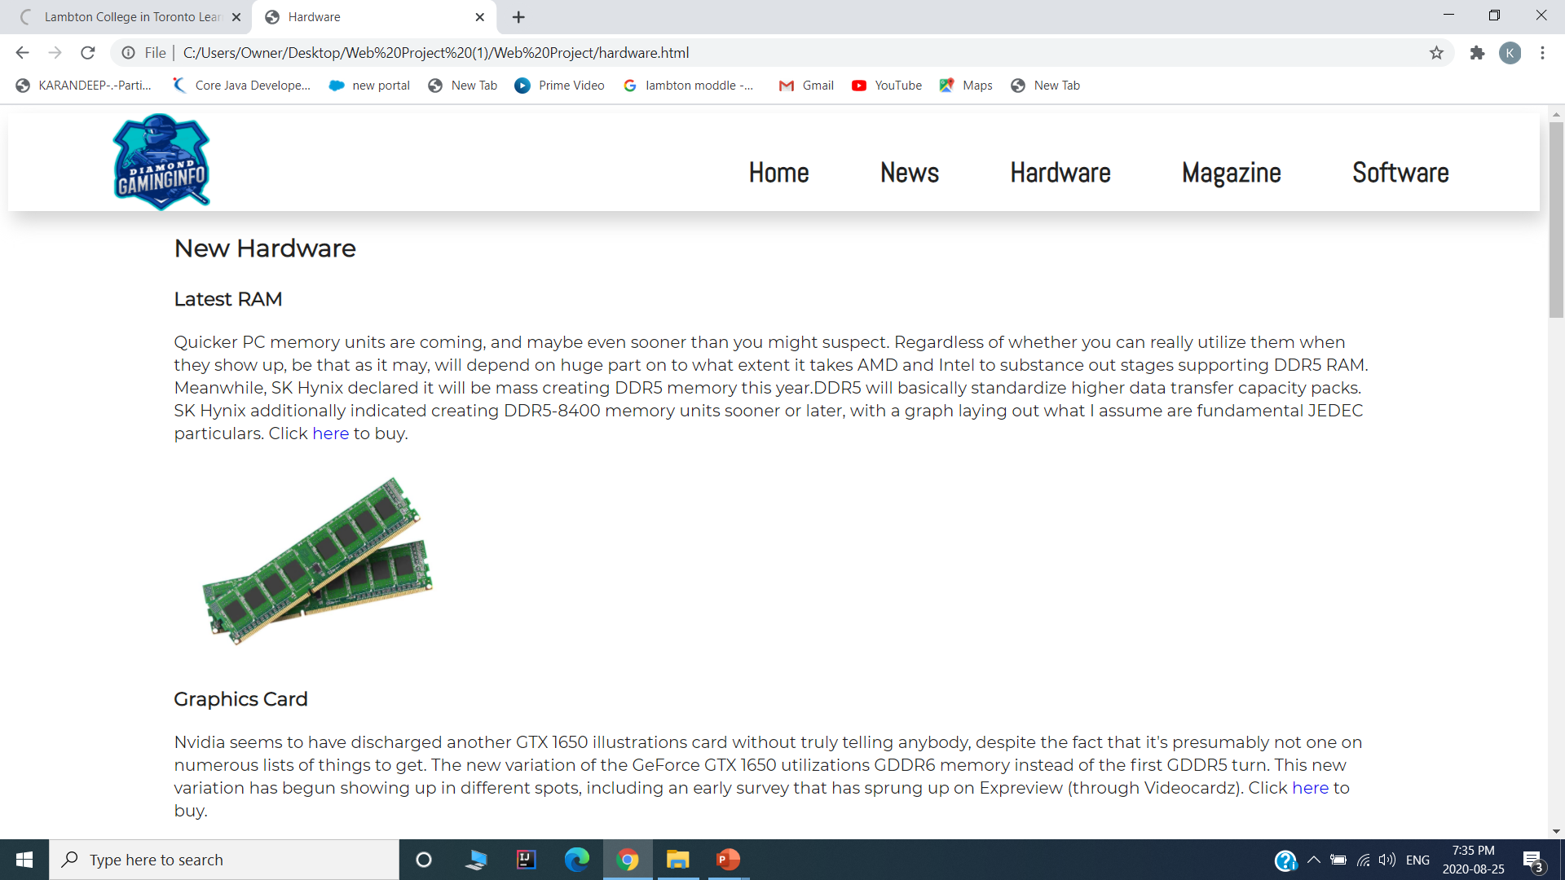
HARDWARE

Slide 5
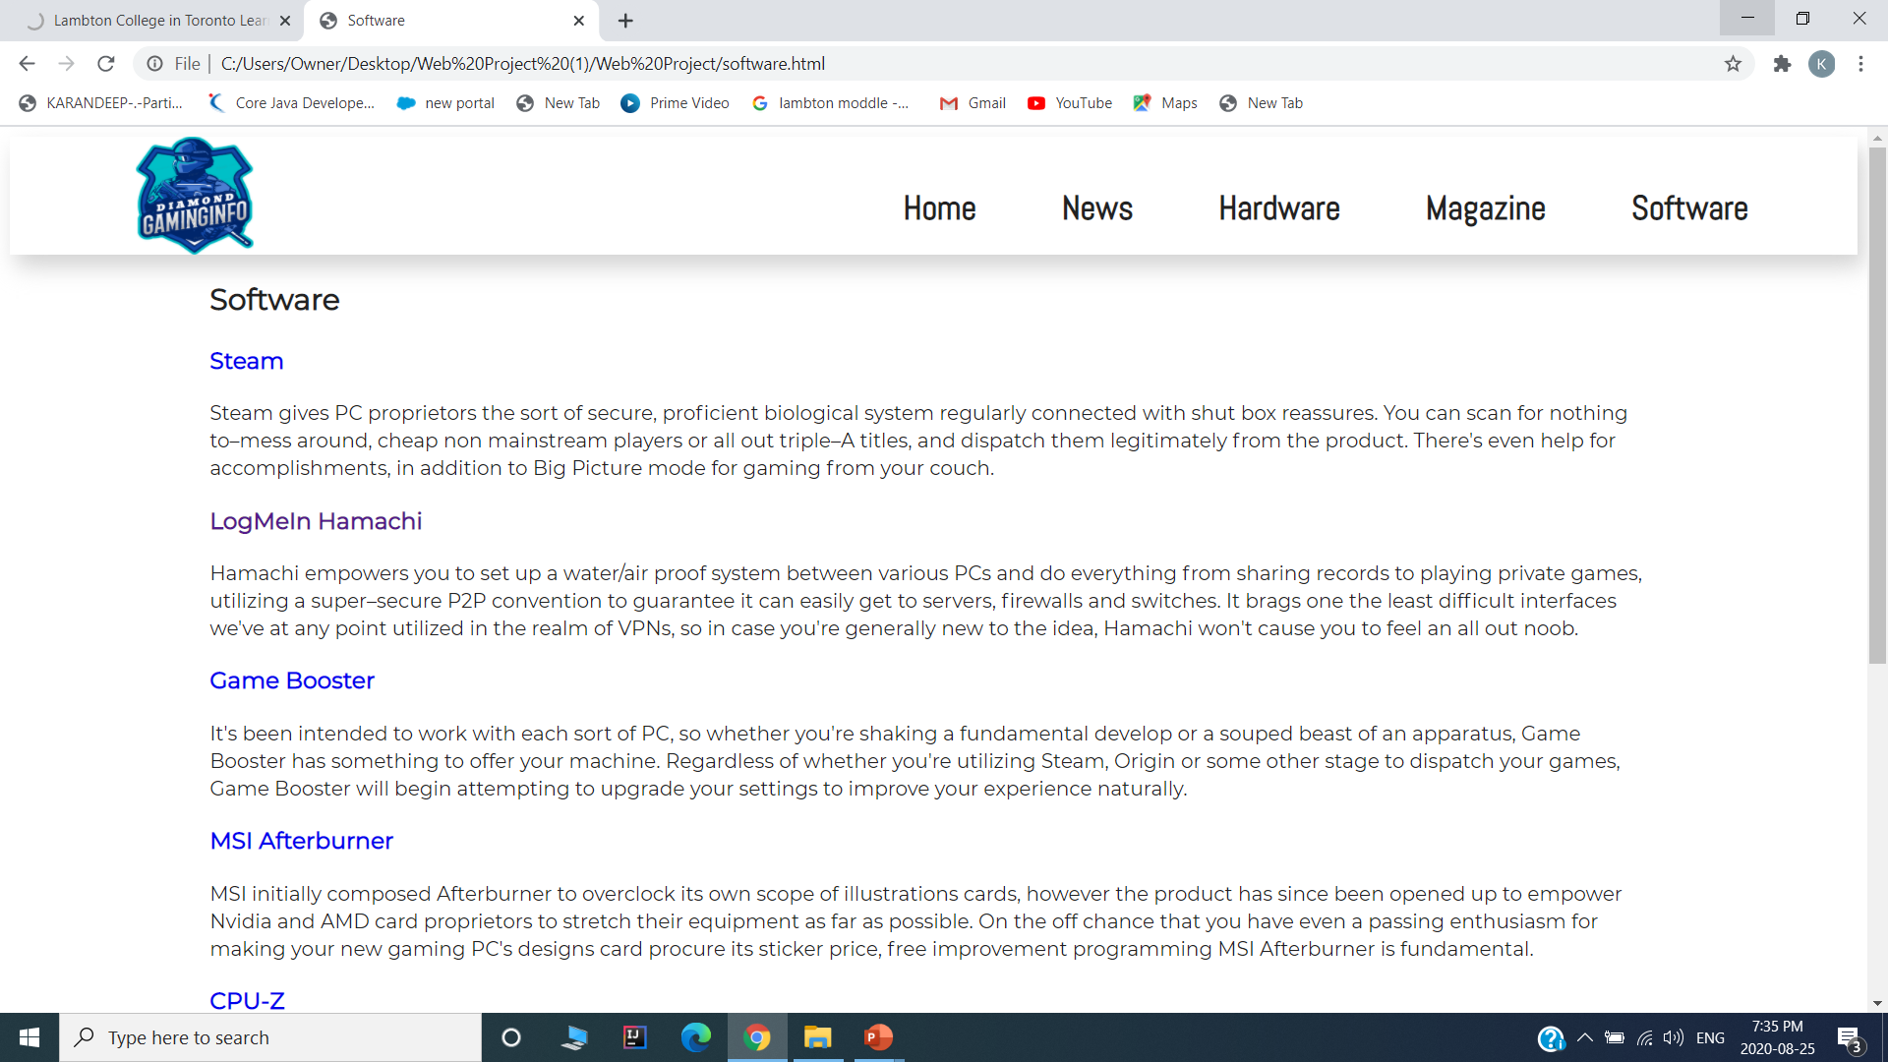
SOFTWARE

Slide 6
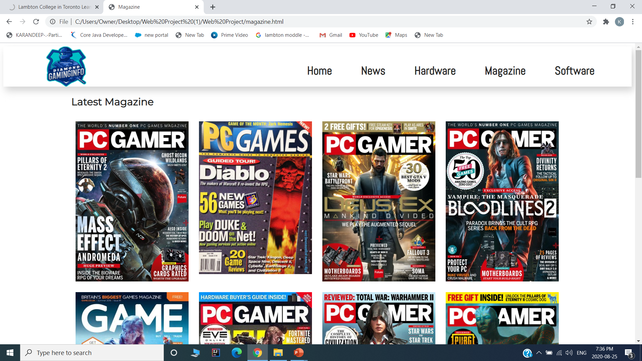
MAGAZINE

Slide 7
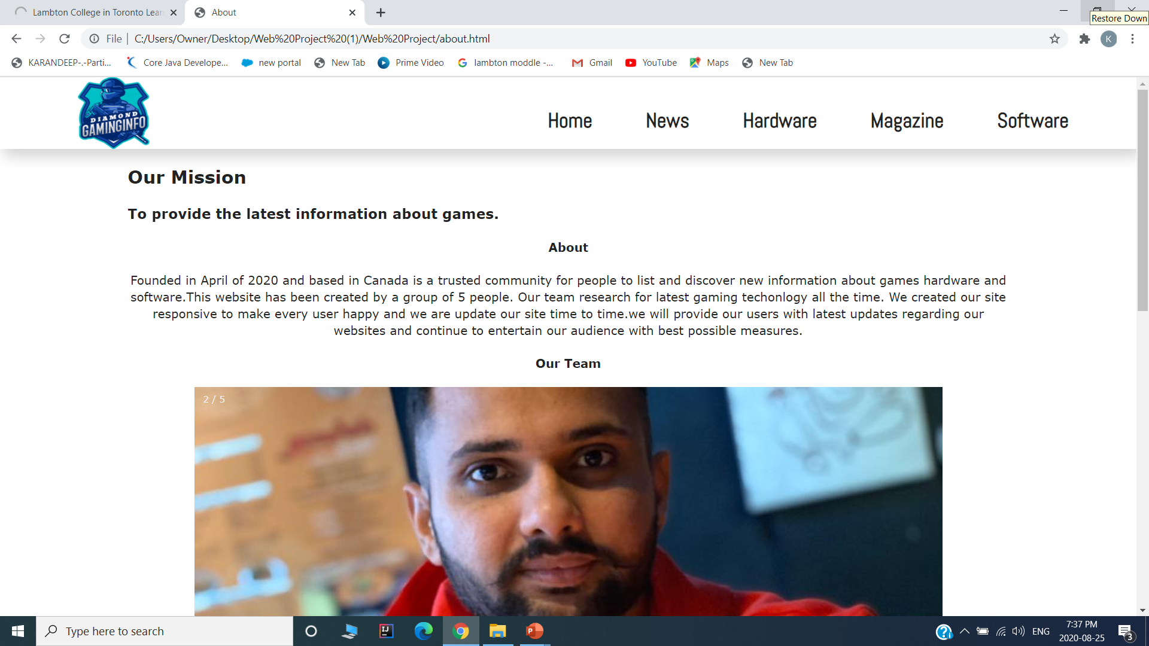
ABOUT

Slide 8
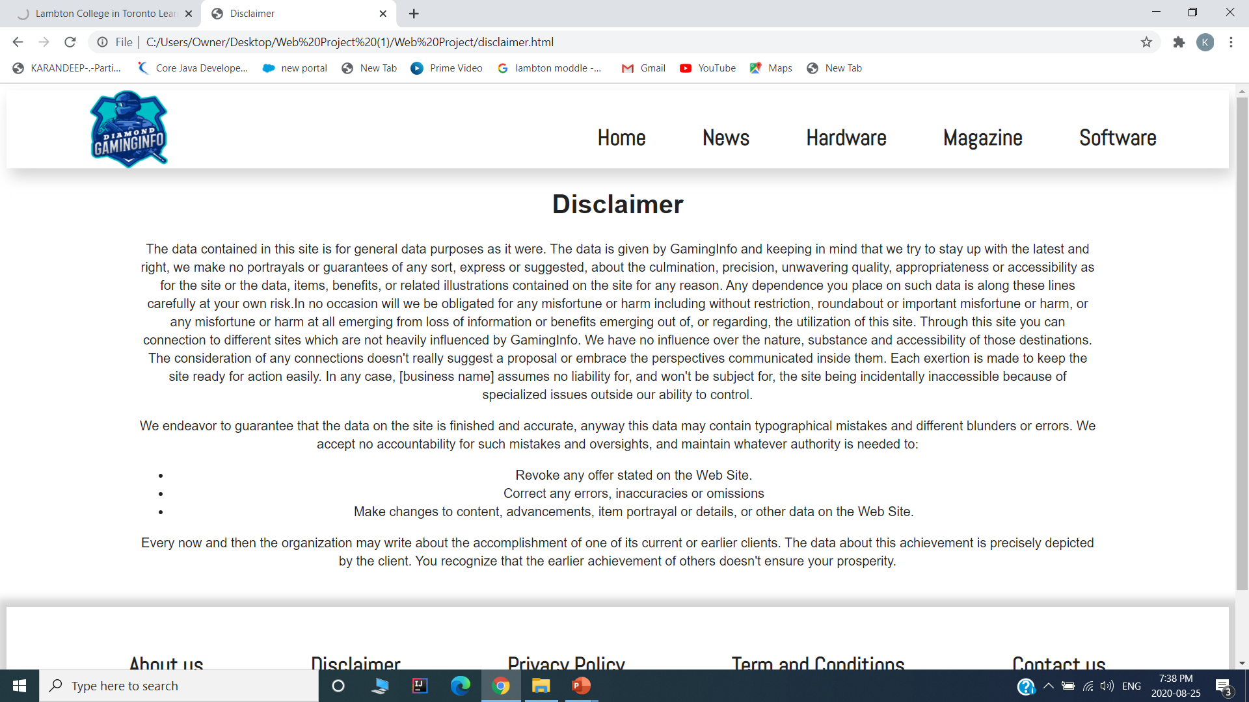
DISCLAIMER

Slide 9
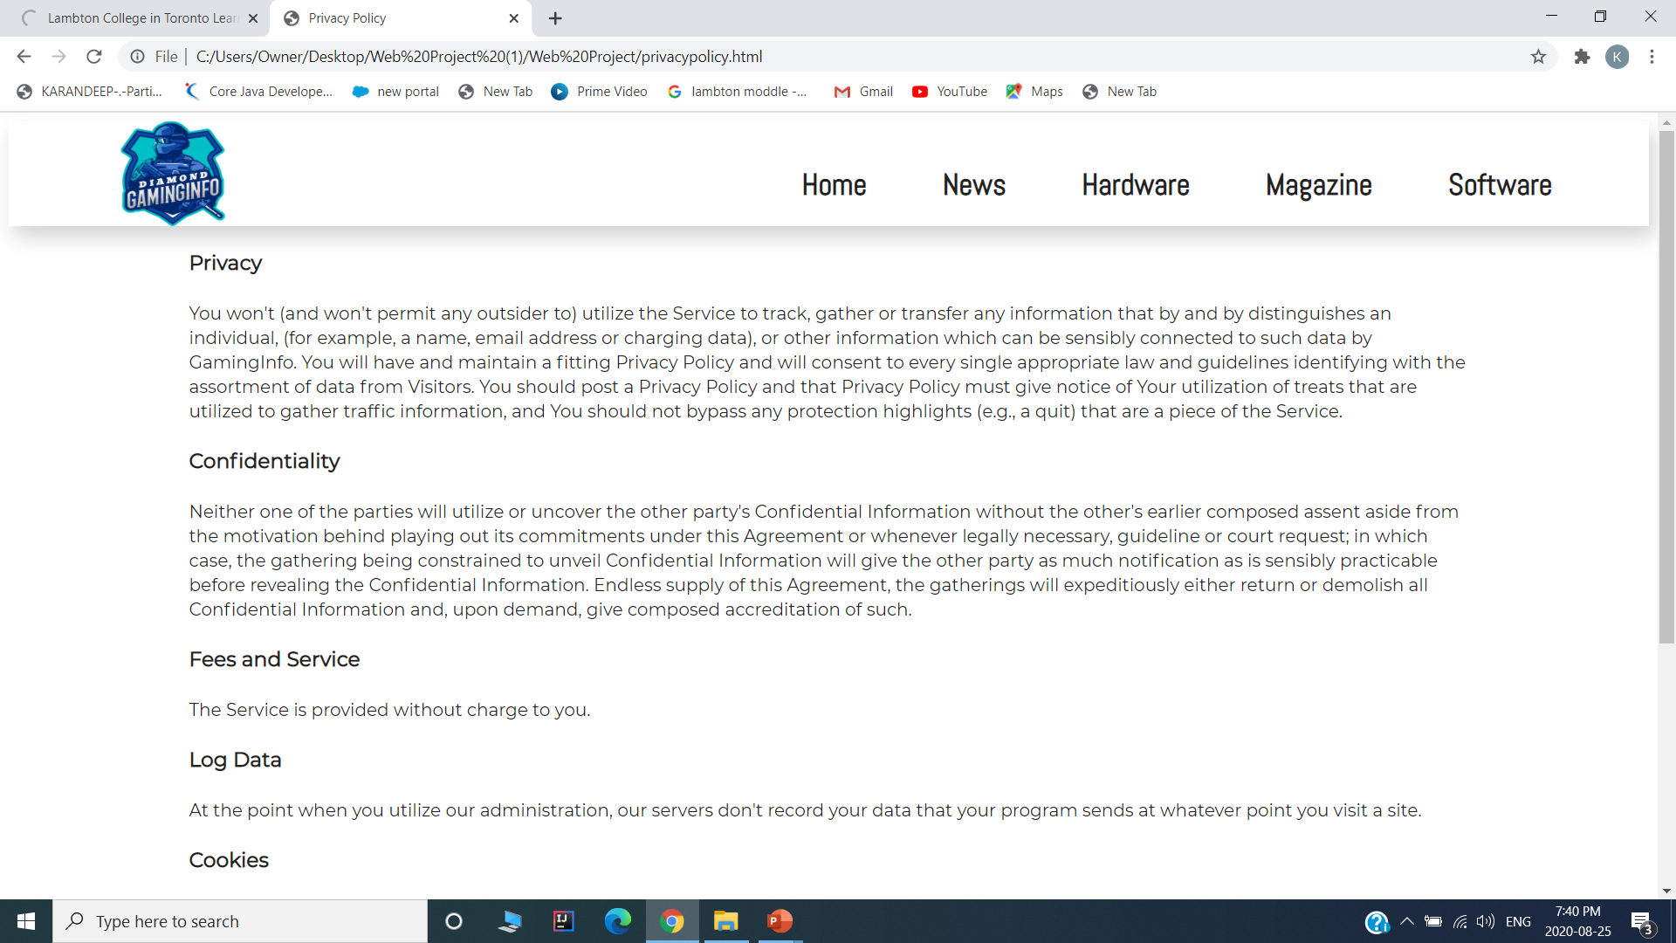
PRIVACY POLICY

Slide 10
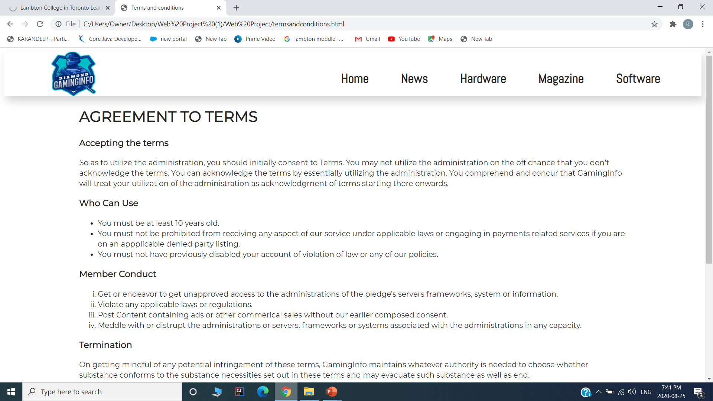
TERMS AND CONDITIONS

Slide 11
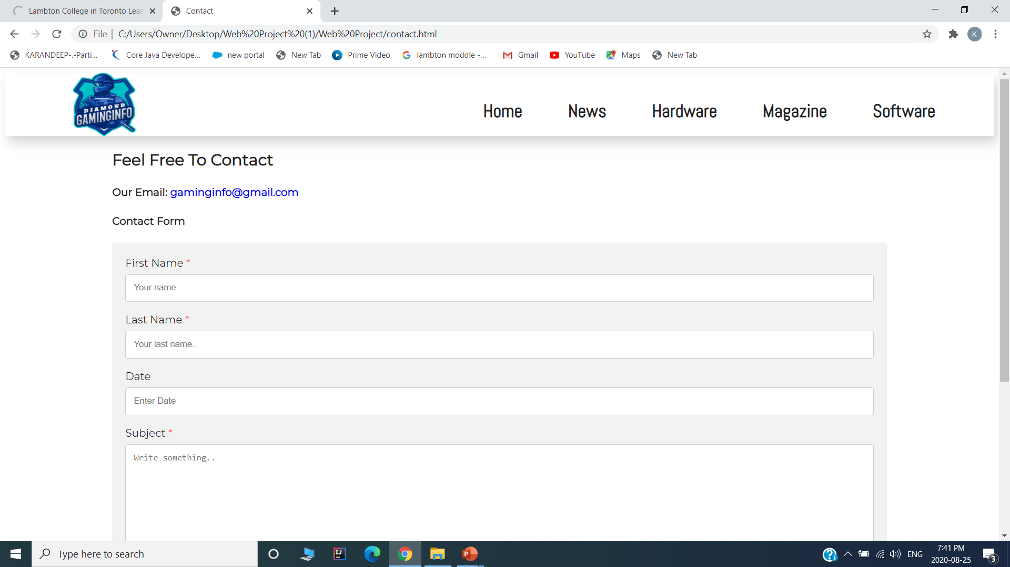
CONTACT US

